Slide 1
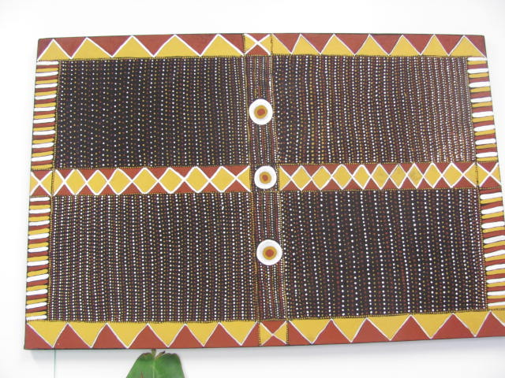
Palmerston / Tiwi Islands C4C Participatory Evaluation Process
Awarded the 2012 Australasian Evaluation Society Award for Excellence in Evaluation
Community Development Award
Presented to the NT AES Regional Seminar 13 June 2013 by Nea Harrison (Pandanus Evaluation & Planning Services) and Therese Puruntatameri (Australian Red Cross NT)

Slide 2
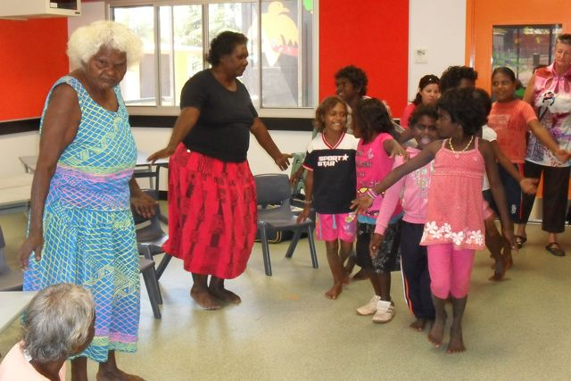
Background
The Australian Red Cross NT manages the Palmerston and Tiwi islands Communities for Children (C4C) sites
Long term commitment to building the evaluation capacity of Local C4C Committee members as a way to
  strengthen community decision-making
  increase the quality of programs
  Programs are more responsive to community needs
The design of the Program was influenced by:
  extensive community consultation with Tiwi people to plan the new program
  results of the evaluation of the first C4C Program in Tiwi Islands and Palmerston
Notes:
Rachel and Teresita
The Australian Red Cross NT manages the Palmerston and Tiwi islands sites for the Communities for Children Activity
Commitment to build the evaluation capacity of the Communities for Children (C4C) Local Committee members as a way to strengthen community decision-making and increase the quality of C4C programs.
The aim is for Agencies to provide programs for children and families that are more responsive to local needs and accountable to local people as a result of greater local involvement and careful examination of the programs
The design of the Program was influenced by:
the results of the Evaluation of the first C4C Program in Tiwi Islands and Palmerston and
feedback from extensive consultation with people on Tiwi Islands during the planning stage of the new program

Slide 3
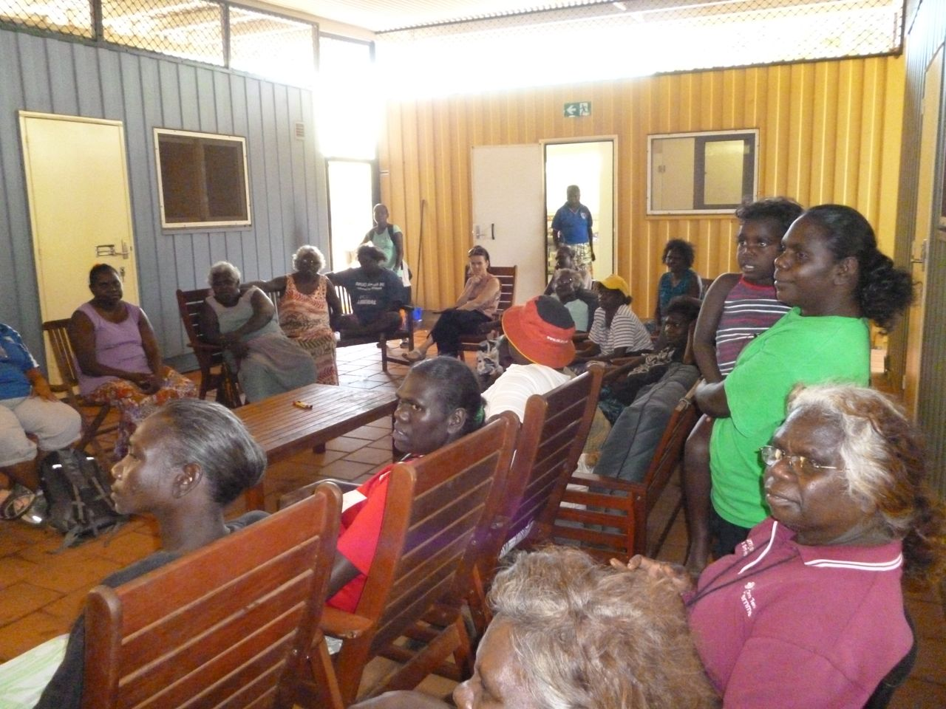
The Model
Establish and support local committees and a Joint committee to make decisions
  To build local decision making capacity and
  Ensure community input to decisions made about what programs to fund and how to deliver them
Employ local people in key roles
  Nimarra workers from each Tiwi Islands communities support the ARC
  Nimarra Worker Coordinator
  Palmerston Project Officers
Contract an evaluator to work beside the Project
  to train and work with local evaluation teams
  and with community Partners to support their monitoring and review activities
Notes:
Joan
Establish and support local committees and a Joint committee to make decisions
To build local decision making capacity and
Ensure community input to decisions made about what programs to fund and how to deliver them
Employ local people in key roles
Nimarra workers from each Tiwi Islands communities support the ARC
Nimarra worker coordinator
Palmerston Project Officers
Employ an evaluator to train and work with local evaluation teams
Works with Local Committee and interested community members to build their evaluation skills and evaluate the programs conducted in their communities
Works with community Partners to support their monitoring and review activities

Slide 4
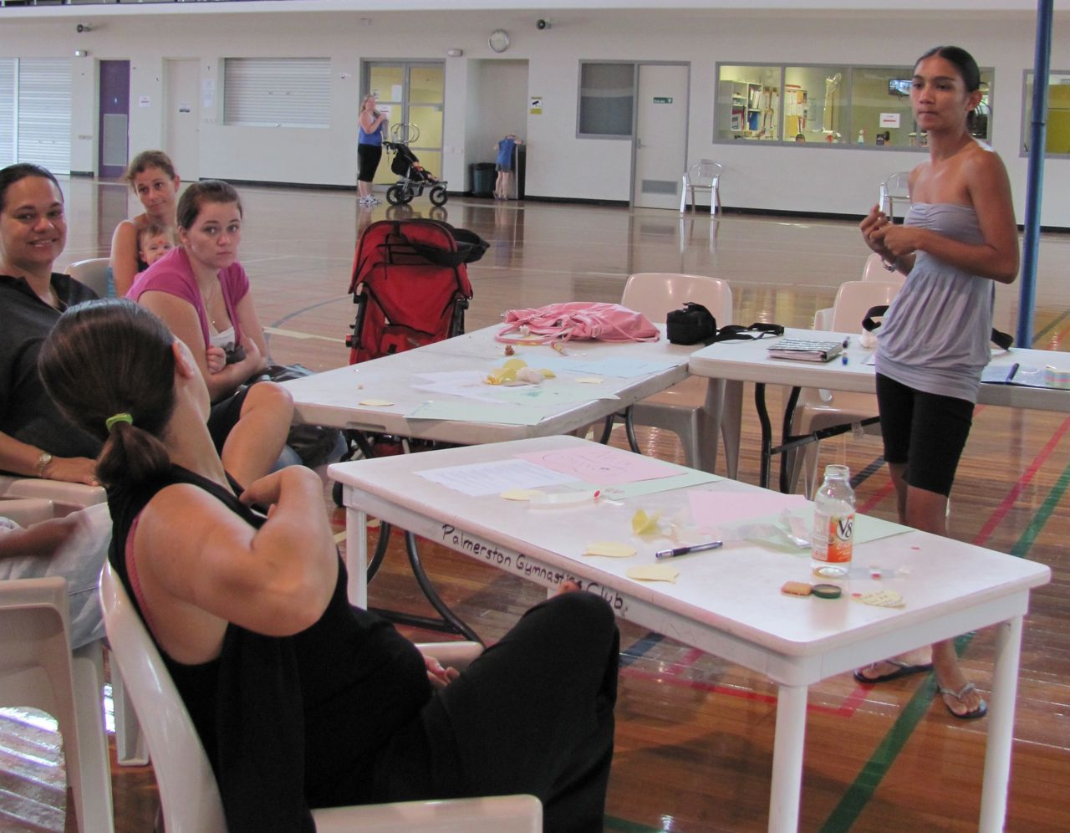
Key elements of the evaluation process
Strengthening evaluation capacity of Local Committee members and Community Partner agency staff to manage and conduct responsive evaluation through regular workshops and meetings
Participatory development of a monitoring and evaluation framework
Regular reports and review of evaluation findings with Community partners and community members to support learning and reflection

Slide 5
Strengthening evaluation capacity
Training local evaluation teams in evaluation methods
Evaluation training and support for Tiwi Islands community members to participate in evaluation of local activities and regular feedback to community about local activities
Strengthening the evaluation knowledge and skills of community partners through regular skills development and evaluation review workshops
Support to community partners in the development of monitoring and evaluation tools for their C4C Activities

Slide 6
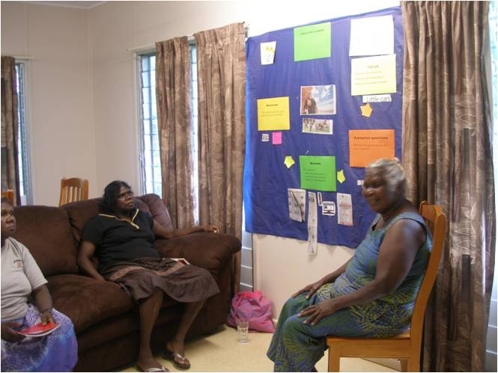
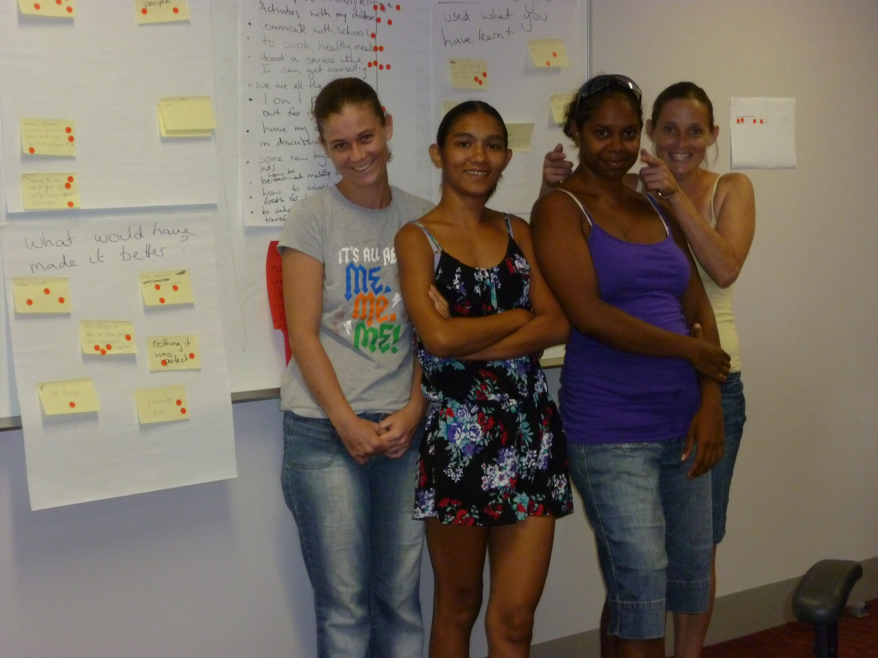
Evaluation planning and training
Notes:
Workshops and training on Tiwi Islands and Palmerston to:
Learn about:
the C4C Program
what evaluation is
what we can achieve by looking at the Activities held in the local community
Plan our evaluation activities
Committee members attended the training and planning workshops run for Community Partners in Darwin so we know what they are doing

Slide 7
Participatory development of a monitoring and evaluation framework
Development of a program logic to describe the program theory and intent
  And individual program logic models for each C4C Activity
Development of key evaluation questions
Development of quality rubric to articulate expectations for a quality program and guide the assessment of the quality and value of the C4C Activities
Establishment of a systematic monitoring and evaluation process that enabled an evidence base to be built and tested

Slide 8
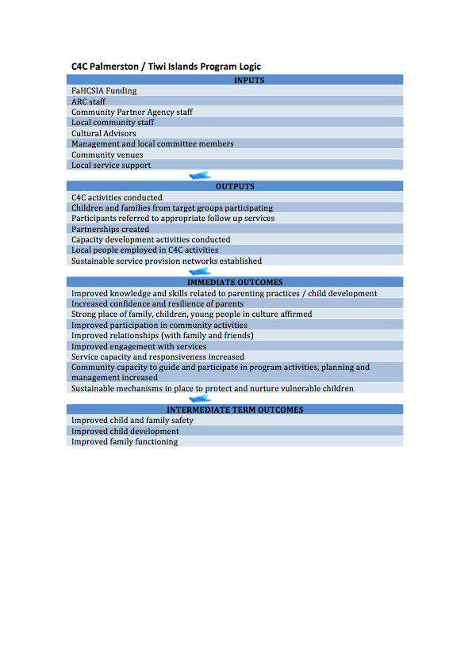

Slide 9
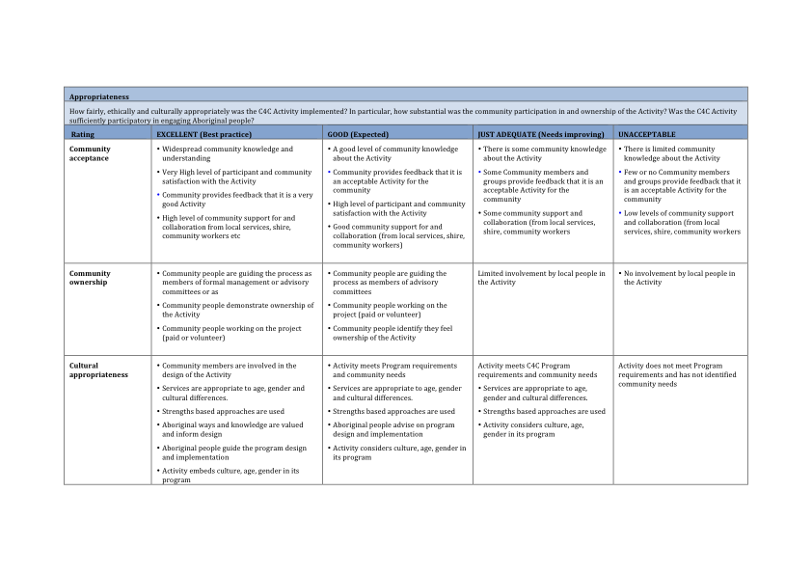

Slide 10
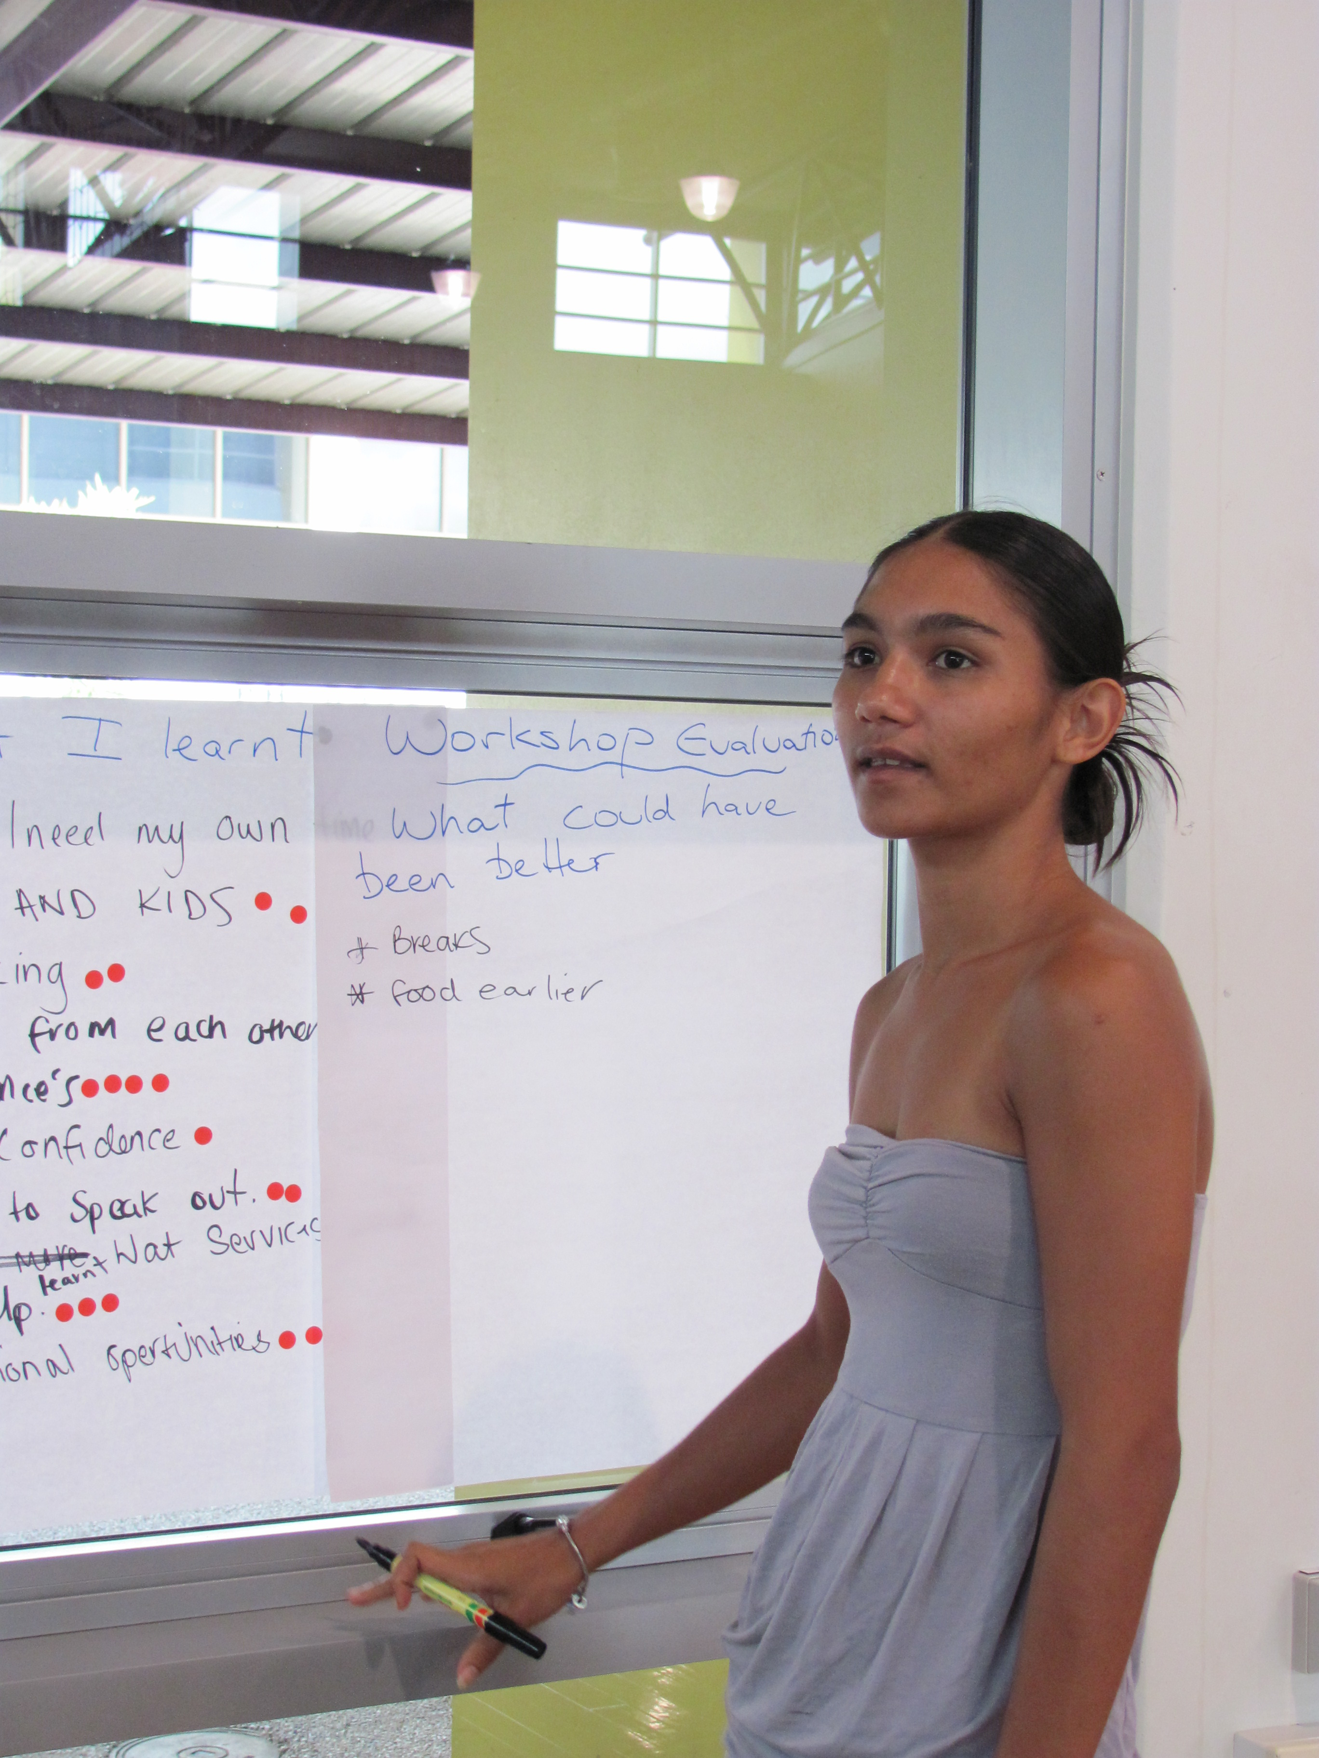
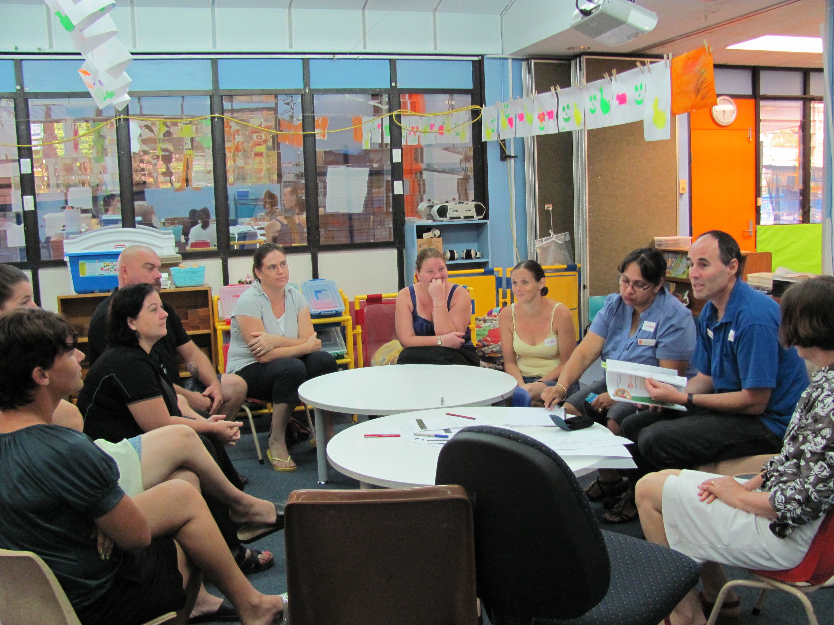
Data collection workshops

Slide 11
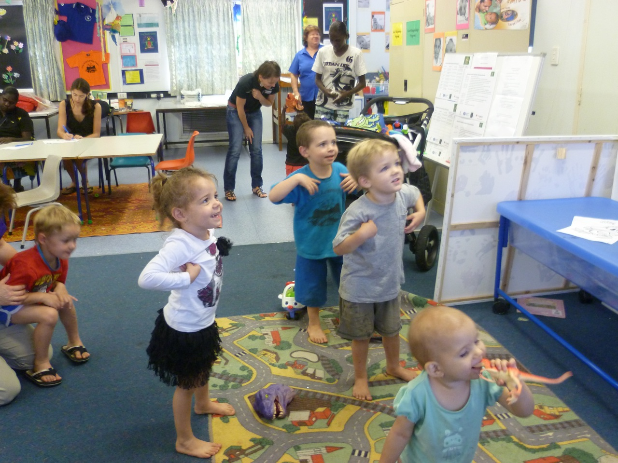
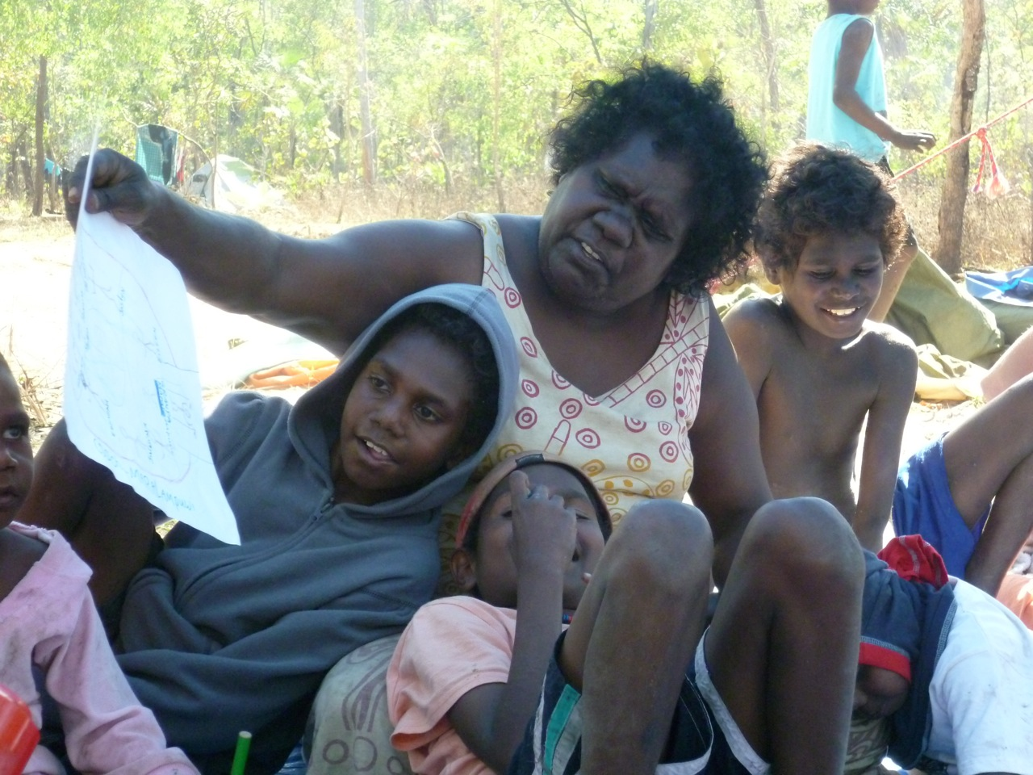
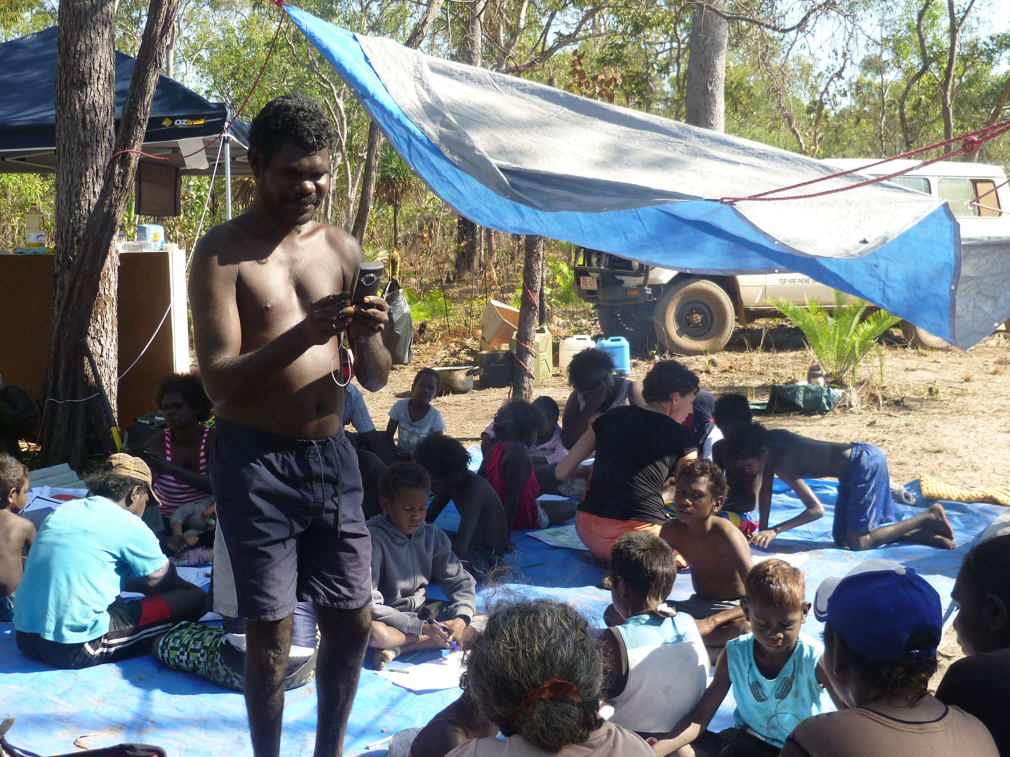
Observation

Slide 12
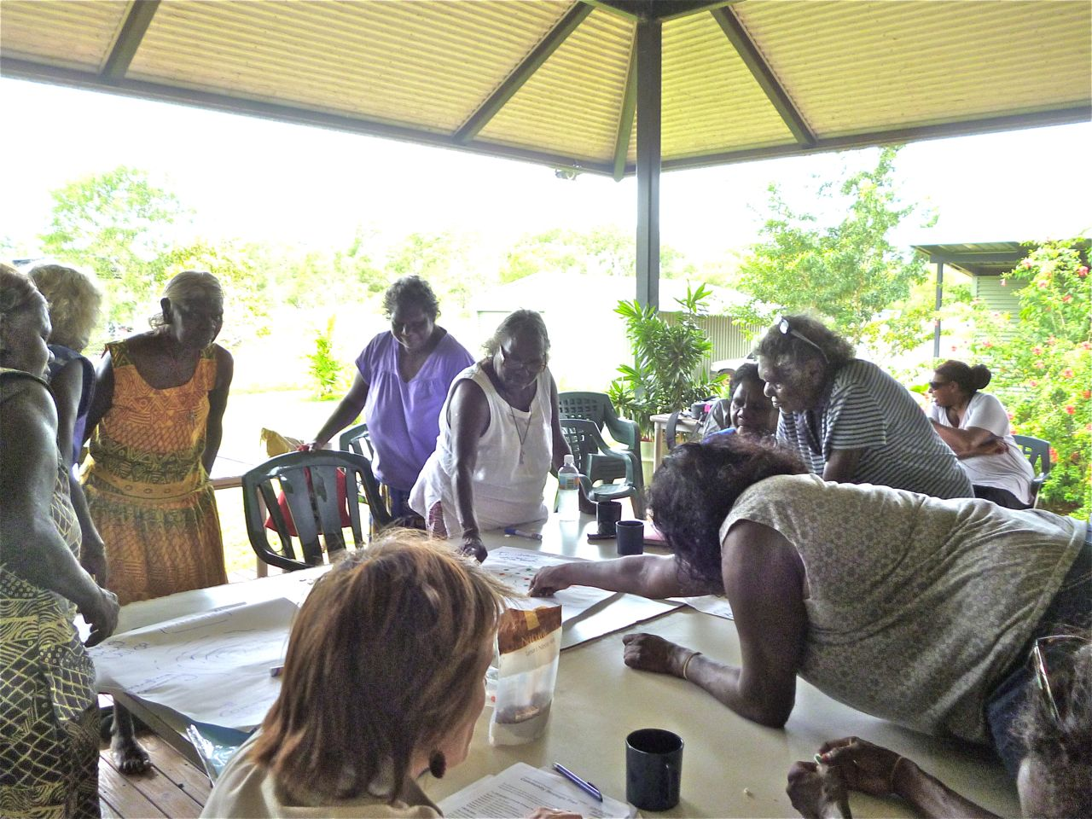
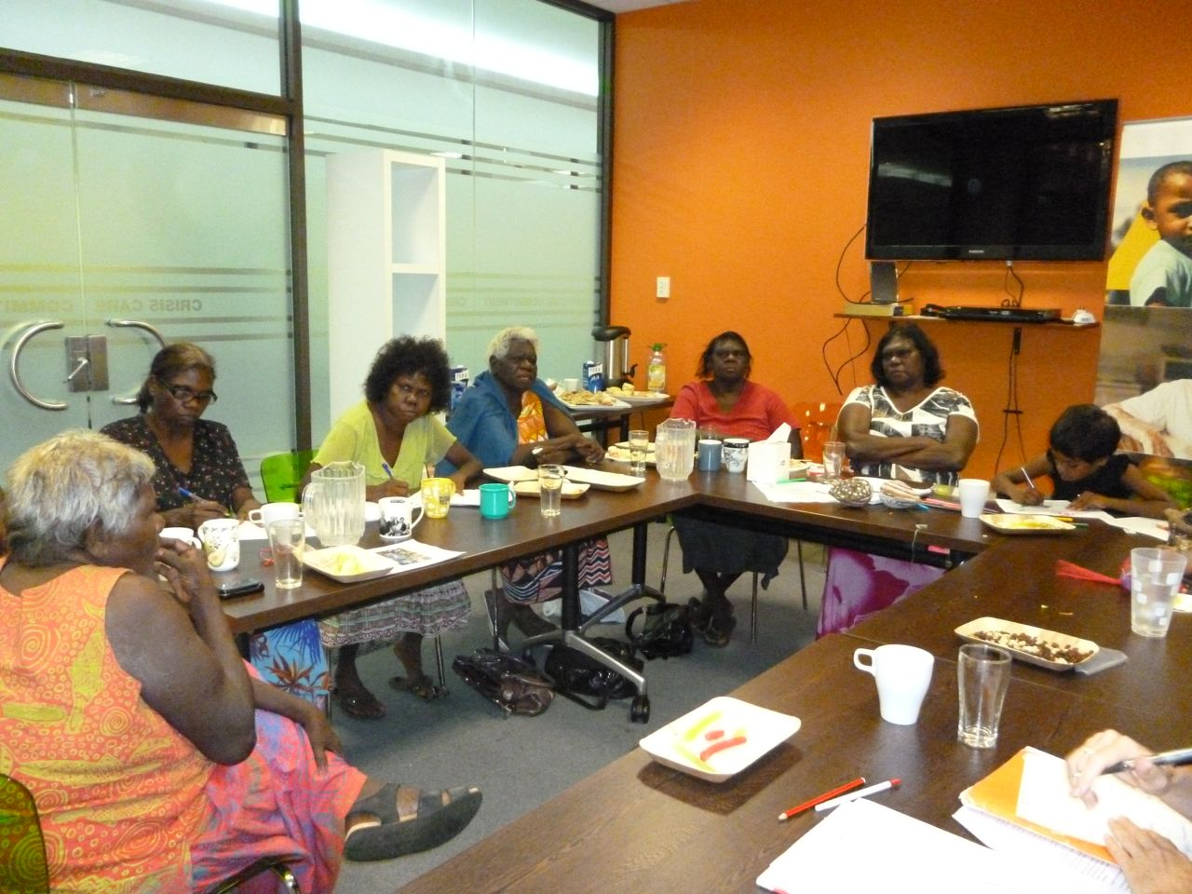
Expert Panels

Slide 13
Regular reporting and review of evaluation findings
Six monthly reports to the C4C Joint and Local Committees about evaluation activities and findings to enable ongoing reflection and improvement of Activities
Feedback to Community Partners
Feedback to community members and services after each data collection activity to share and review findings
Participant evaluation workshop reports

Slide 14
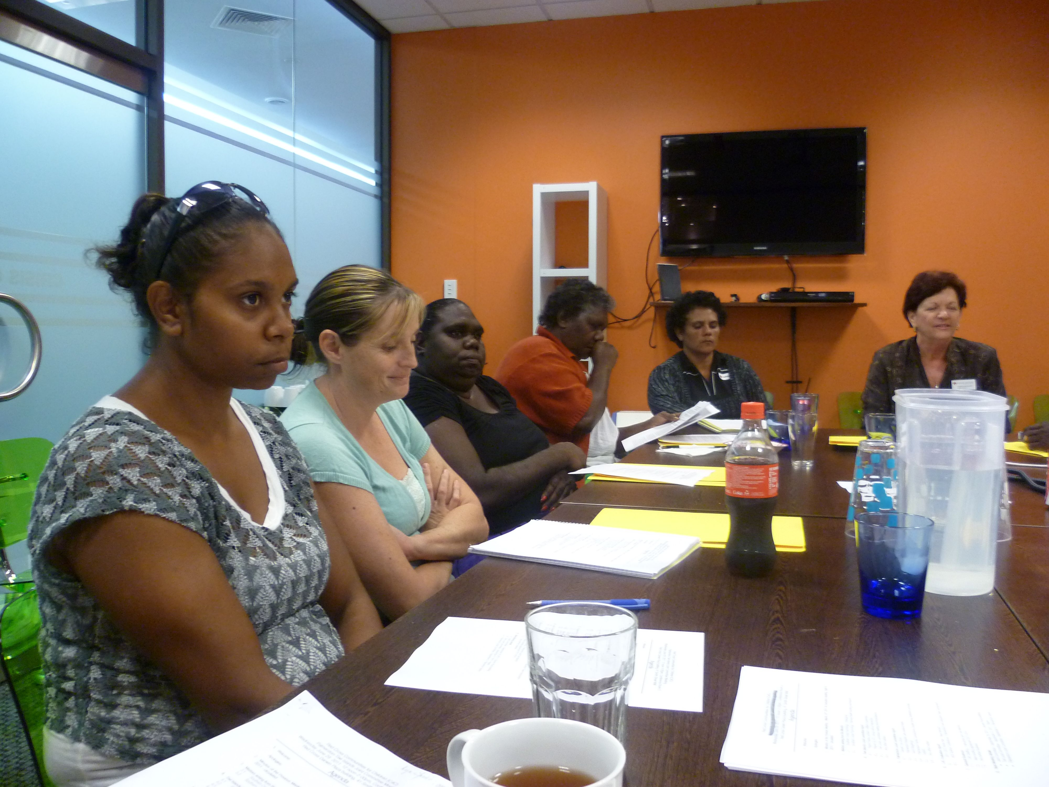
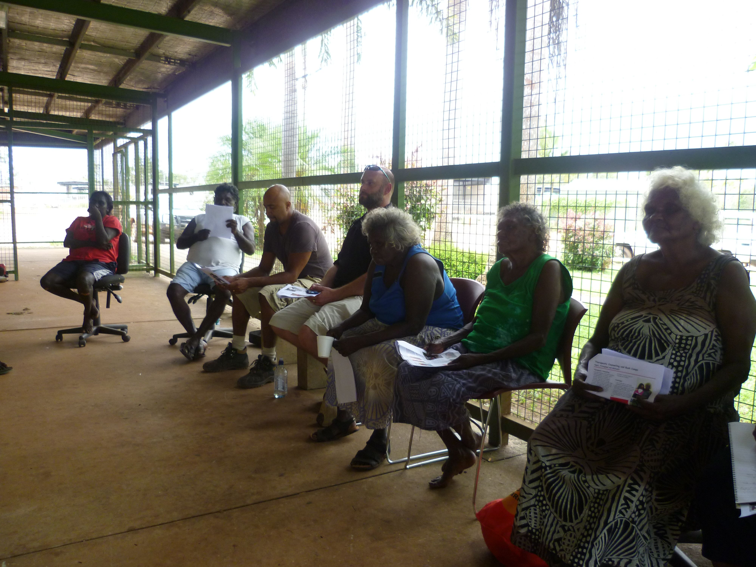
Feedback to committees and community members
Joint committee meeting in Darwin
Community feedback in Wurrumiyanga

Slide 15
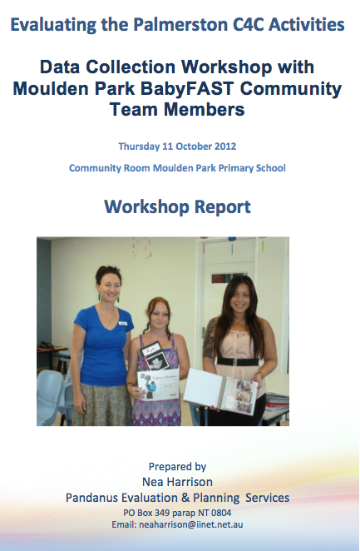
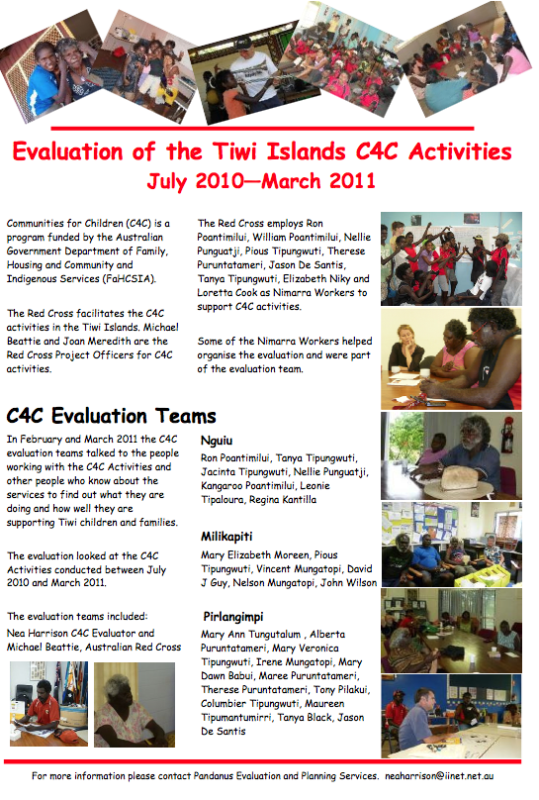

Slide 16
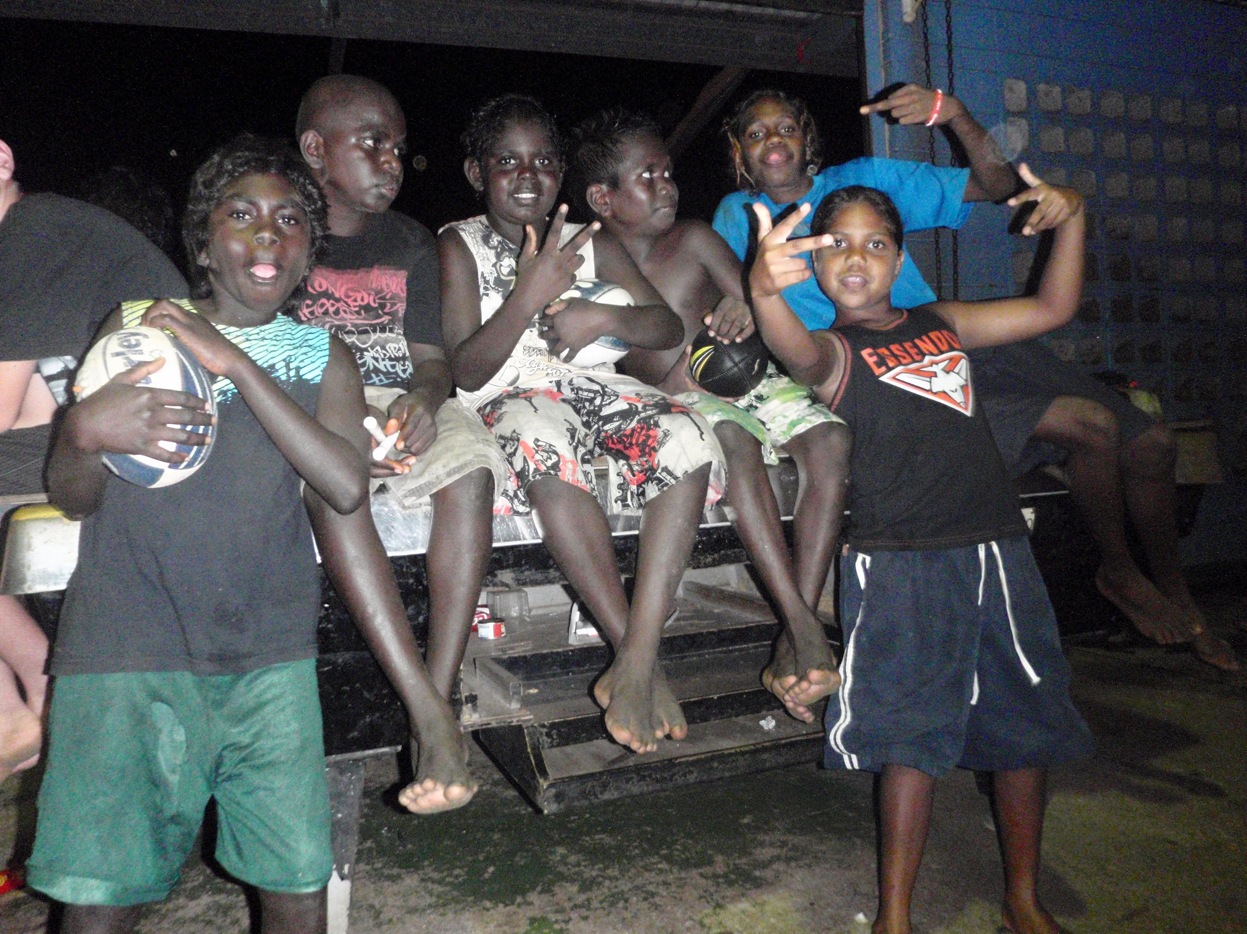
Use of findings
Committees make decisions about what programs to:
  support
  fund and
  change

Slide 17
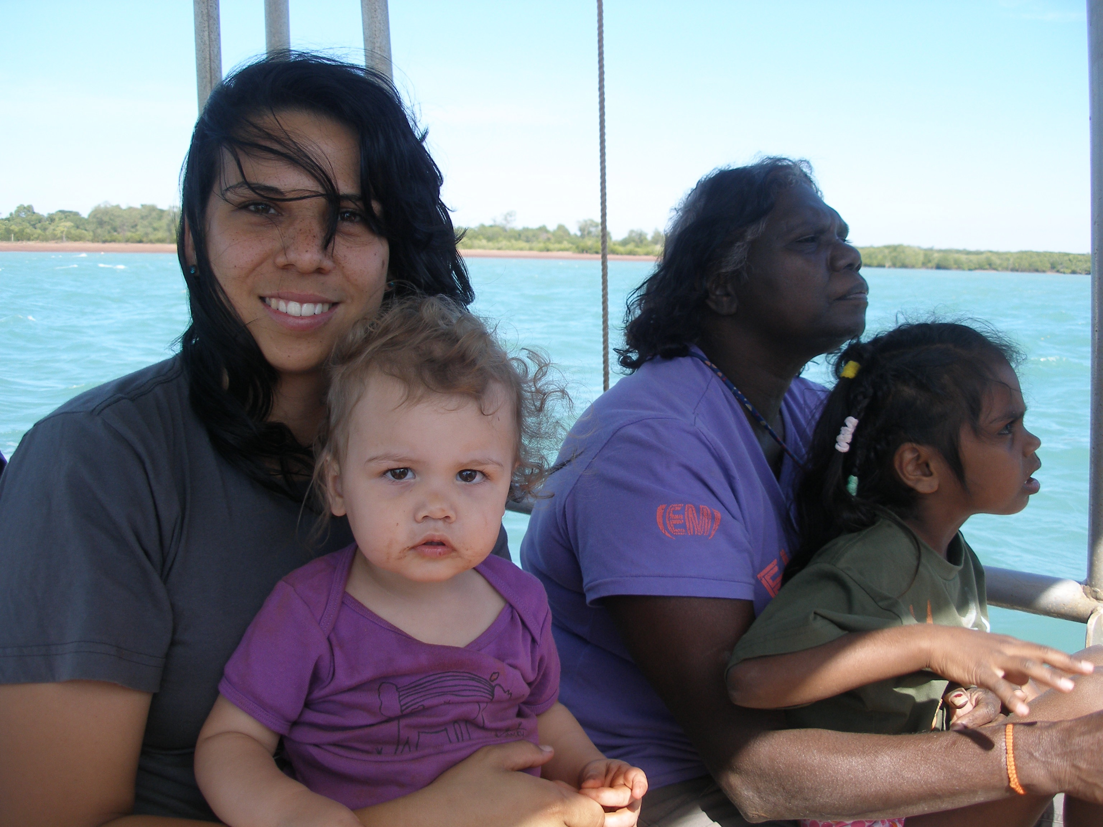
Outcomes from the Evaluation processes

Slide 18
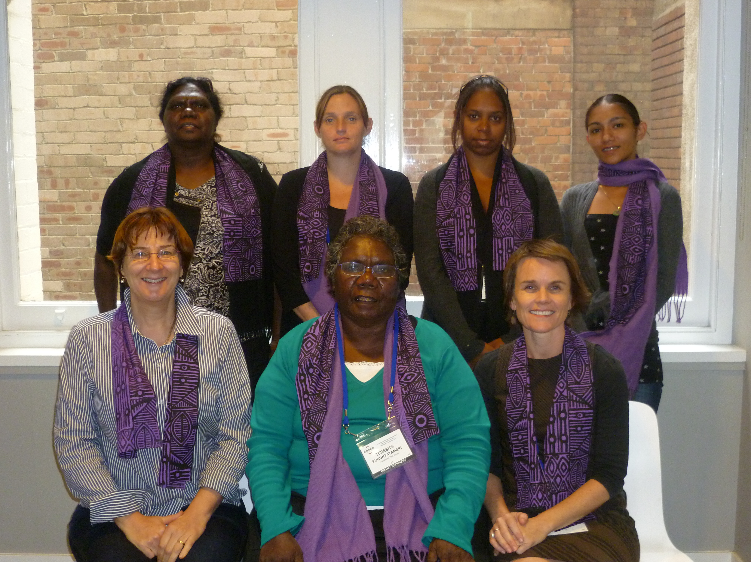
Outcomes for evaluation team members
Built confidence in ourselves
Learnt how gather information and evaluate programs
We developed and run the data collection workshops
We get more respect
We feel we are making a valuable contribution to the community
We see ourselves as valued members of the community and the program
It has led to new jobs or roles for all of us here at the conference
Notes:
(Narelle and Stacey helped out by everyone else ) (5 mins)
Built confidence in ourselves – our own skills
Learnt about how to do evaluation, how gather information and evaluate programs
We developed and run the data collection workshops
People in the community see us as more professional
We get more respect from Service providers and community members.
We feel we are making a valuable contribution to the community
We see ourselves as valued members of the community and the program
It has led to new jobs or roles for all of us here at the conference
Examples
Narelle has moved from chair of the committee to being employed by ARC
Therese employed as Nimarra worker and now coordinator
It has given Nimarra workers a better understanding of the Activities and led to us being more involved in the Programs

Slide 19
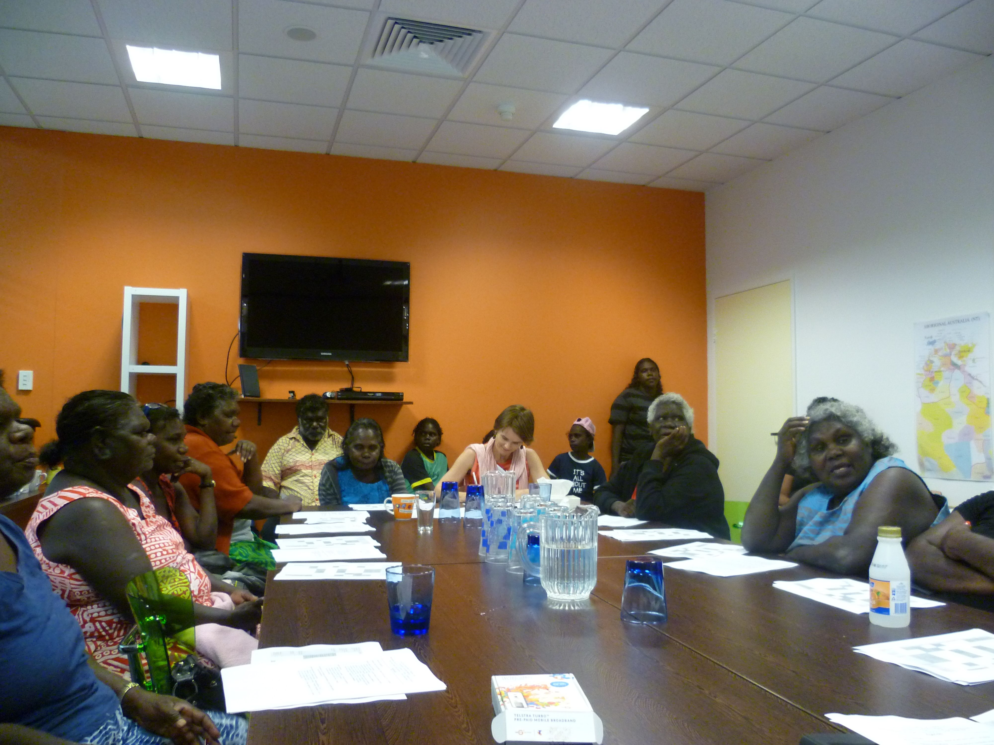
Outcomes for committees
Being involved in evaluation
Shows committee members what to look for in a good program
Helps committee members make decisions about:
  which programs to support
  what changes need to be made to improve programs
Notes:
Teresita and Joan
Being involved in the evaluation and getting regular evaluation information:
Shows committee members what to look for in a good program
Has shown us know what a good program looks like
Has strengthened the capacity of the C4C local committee members to make decisions about which programs to support and what changes need to be made to improve programs
Example:
When evaluation showed that bush camps worked well, the Committee decided to put more funding into them
Committee decided to provide additional funding for FAST program in a suburb that had no support

Slide 20
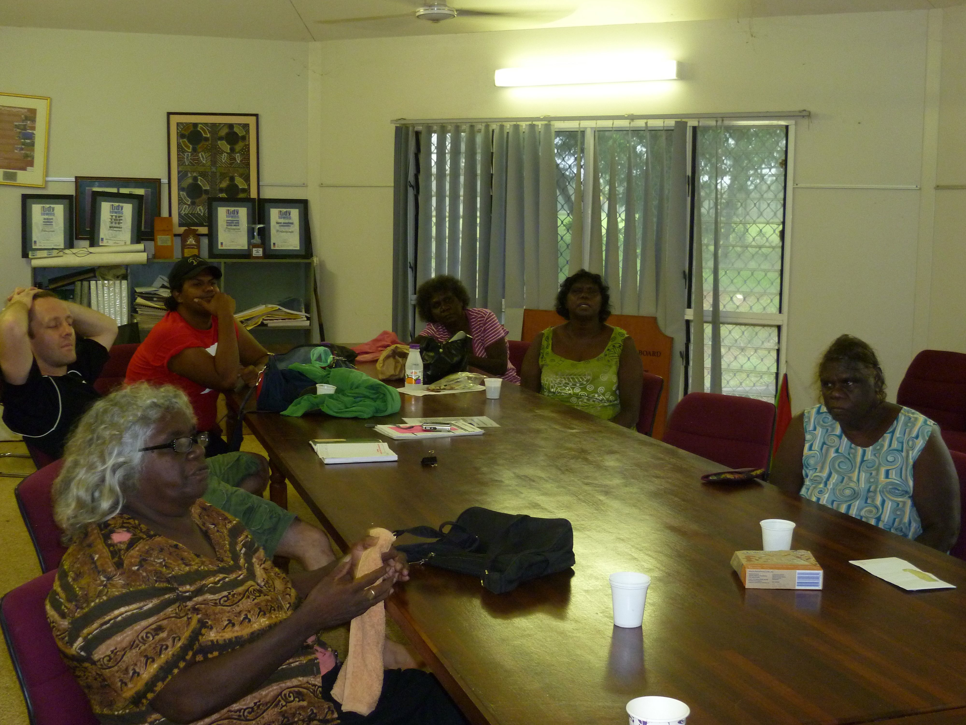
Outcomes for community
Gives people a much better knowledge of what the programs delivered in their community:
  aim to achieve
  what they should be doing
Lets people hear stories of successes and failures
Gives community members influence over the programs run by external agencies
Ensures that programs benefit the community
Notes:
(Therese and Teresita) (5 mins)

Slide 21
Outcomes for families and children
As a result of the regular and open evaluation activities participants :
  feel valued
    They have been invited to have their say about their programs
  are kept in the loop
    we provide get regular feedback about the evaluation
  are starting to own the programs
    (e.g. organising and running fun days, camps)

Slide 22
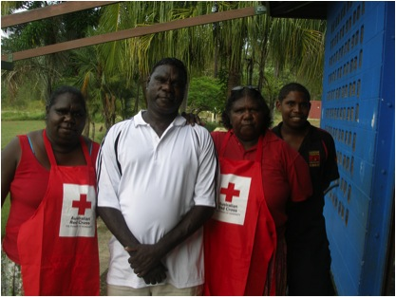
Outcomes for the C4C Program
Building evaluation capacity has added value to the C4C Program
It has enabled the ARCNT to ‘give back’ to communities:
  To invest in the community
  To employ local people
The evaluation is more robust because key community people, young mums are asking the questions
Nimarra workers have improved their knowledge about the C4C programs and their knowledge of the programs has helped the evaluation
Notes:
(Rachel and Joan) (5 mins)
Building evaluation capacity has added value to the C4C Program. It has enabled the ARCNT to ‘give back’ to communities:
To invest in the community
To employ local people
The evaluation is more robust because key community people, young mums are asking the questions
The evaluators are local people who can put themselves in the “shoes of the community” better than outside evaluators could
Nimarra workers have improved their knowledge about the C4C programs and their knowledge of the programs helped the evaluation

